Slide 1
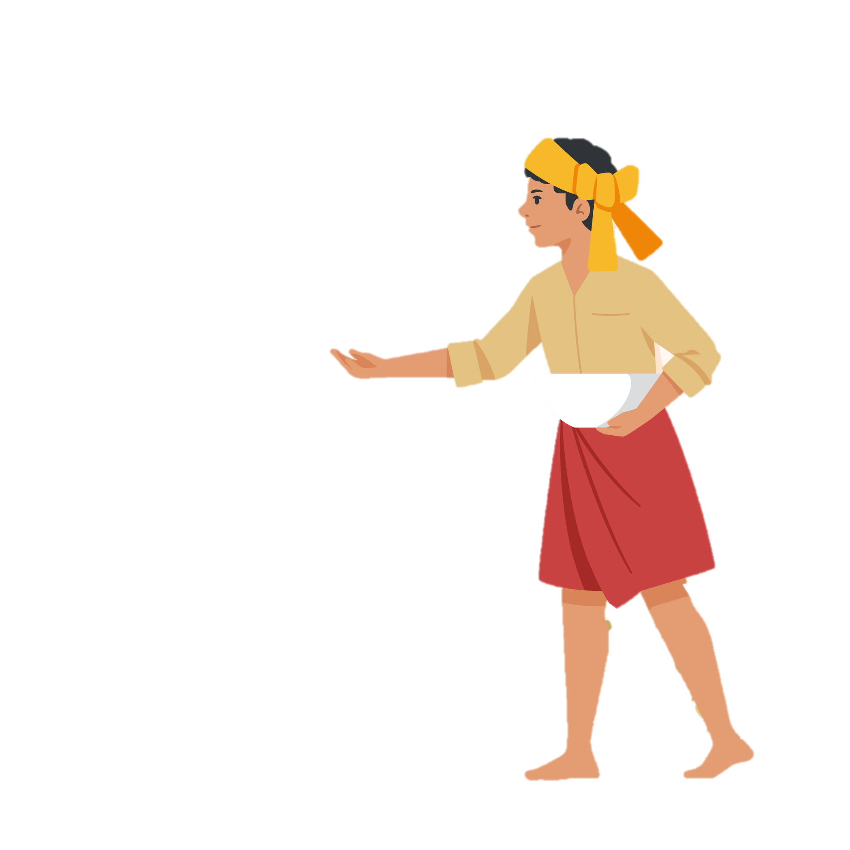
FARMBUDDY
A web-based Application for Agriculture Assistance
URK21AI1020 ANVIN SHAIJU
WEB TECHNOLOGY 20CS2056
MINI PROJECT
PROJECT BASED LEARNING 2022-2023

Slide 2
Contents
OBJECTIVE | 1
INTRODUCTION | 2
SOFTWARE USED | 3
USE-CASE DIAGRAM | 4
ARCHITECTURE-DIAGRAM | 5
SEQUENCE DIAGRAM | 6
LIST OF MODULES | 7
MODULE EXPLANATION | 8
IMPLEMENTATION DETAILS | 9
OUTPUT SCREEN | 10
BENEFITS OF APPLICATION | 11
CONCLUSION | 12

Slide 3
Table of contents
01
Project’s objectives
04
Solutions
02
Resources
05
Communication plan
03
Our budget
06
Conclusion

Slide 4
Objectives
THE AIM
THE GOAL
To create a website where farmers and other people interested in agriculture may get all the information they need about the crops, from their growing to their sale and marketing.They may also receive assistance from experts in agriculture, as well as learn about government programs that are relevant to their crops and crop-related news.On the same website, they may buy and sell their mass manufacturing.
Create a comprehensive platform for farmers to handle everything under a single window

Slide 5
INTRODUCTION
A internet initiative created primarily to assist farmers in accessing government agricultural programmes, selling their goods, and growing crops. We are devoted to helping farmers in any way I can since I recognise that it may be a difficult endeavour.
Farmers may access a variety of tools and services on THE platform. First off, thorough information and recommendations on crop cultivation, including the best practises, crop selection, soil health, pest management, and other relevant subjects. Farmers can contact team of specialists with any questions they may have about crop production.
Second, a marketplace so that farmers can sell their goods directly to customers, cutting out middlemen and guaranteeing that farmers get paid fairly for their commodities. Farmers may purchase agricultural inputs including seeds, fertiliser, and equipment at affordable costs in addition to selling their output.
Thirdly, assist farmers in gaining access to government programmes for agriculture, including loans, insurance, and subsidies. Provide info to farmers about these programmes' eligibility requirements, application procedures, and deadlines so they can benefit from them.
My internet project's overall goal is to provide farmers with the knowledge and tools they need to succeed in their line of work.

Slide 6
SOFTWARE USED
CODING PLATFORM
Routing & logical calulation
Base –Web page
DataBase
Designing
Running Platform
Vscode By Microsoft
Angular js
HTML
MongoDB and Node JS
CSS and JS(JavaScript)
Microsoft Bing & Google chrome Browser

Slide 7
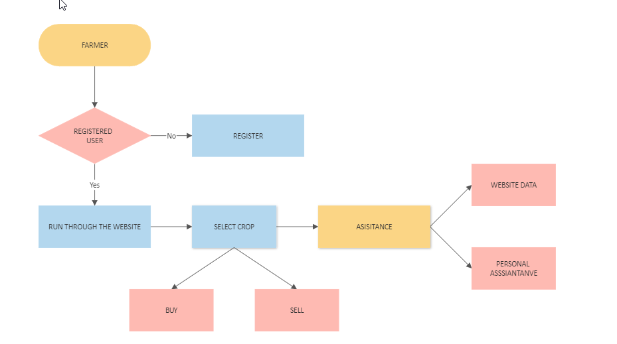
USE CASE

Slide 8
USE CASE DIAGRAM - BUYER
FARMER CLICKS BUY
Amount quoted
ACCEPTS
REJECTS

Slide 9
ARCHITECTURE DIAGRAM
WEB TECHNOLOGY
HTML
CSS
ANGULAR JS
DATABASE
JQUERY
ANGULAR JS FILTERS
ANGULAR JS ROUTING
MONGO DB
NODE JS

Slide 10
SEQUENCE DIAGRAM
SELLER OR FARMER
SELLER
FARMER
ACCESS WEBSITE DATA
SELLS PRODUCT
ASSISATANCE
NOTIFIED TO THE EXPERT
QUOTES THE MONEY
NOTIFIES THE SELLER

Slide 11
List of modules and module explantion using VS code and website presentation

Slide 12
25%
200 units
Net profit of the project
Market share in the industry
Break-even point

Slide 13
IMPLEMENTATION DETAILS
Creating the user interface, building the backend infrastructure, and putting the website live on a server are all phases in the process of implementing a website project for farmers. Here are some implementation specifics for the major website project features
User Registration and Profile Creation
Develop a registration form that captures essential details such as name, address, contact information, and farm size.
Create a user profile page that displays the farmer's details, such as name, contact information, farm size, and crop details.
Crop Cultivation Information:
Develop a database of crop cultivation information, including best practices, soil health, pest control, and other related topics.
Create a user interface for searching and displaying information from the database.(Presently done with test case for demo and no DB)
Government Scheme Access:
Develop a database of government schemes for agriculture, including subsidies, insurance, and credit facilities.
Create a user interface for searching and displaying information from the database, including eligibility criteria, application procedures, and deadlines.
Marketplace for Buying and Selling Products
Deployment:
Choose a web hosting provider and deploy the website on a server.
Set up a domain name and SSL certificate to ensure secure communication between the server and users.
Test the website thoroughly to identify and resolve any bugs or issues

Slide 14
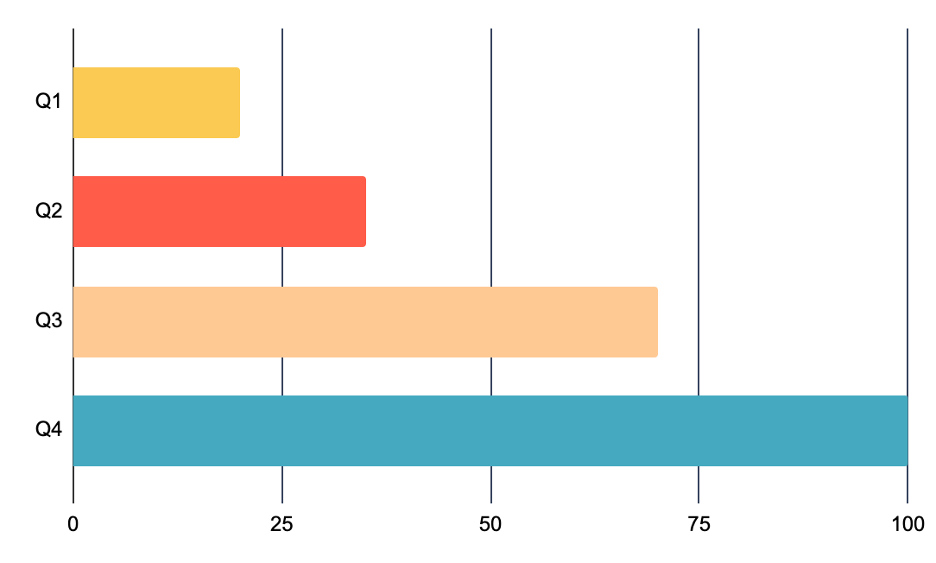
Sales revenue
Sales (in $ thousands)
This column graph represents the sales revenue for a business project proposal in thousands of dollars for each quarter of the year. It shows an increase in sales revenue from Q1 to Q4, indicating a positive trend in the project's performance
Follow the link in the graph to modify its data and then paste the new one here. For more info, click here

Slide 15
Project activities
What? | What is being done? | You can write your answer here
Why? | Why is this task necessary? | You can write your answer here
Where? | Where is it being done? | You can write your answer here
When? | When is the best time to do? | You can write your answer here
Who? | Who is doing it? | You can write your answer here
How? | How is it being done? | You can write your answer here
How much? | How much does it cost? | You can write your answer here

Slide 16

What to show in a mockup
Product/website description: A brief overview of the product/website, including its key features, dimensions, and materials used
Features and benefits: A detailed explanation of the product's/website's features and how they will benefit the user
Technical specifications: A list of the product's/website's technical specifications, such as dimensions, weight, power requirements, connectivity options and hosting platform

Slide 17
Project timeline
Project
5W2H
Results
Market research
Product development
Beta testing
01
02
03

Slide 18
Project roadmap
5W | Action | Jan | Feb | Mar | Apr | May | Jun | Jul | Aug | Sep | Oct | Nov | Dec
What | Increase brand awareness by 30% within the first year
Where | Achieve a customer satisfaction rate of 90%
When | Increase revenue by 20% within the first year
Who | Achieve a customer satisfaction rate of 90% within the first year
Why | Reduce costs by 15% within the first year by expanding the product

Slide 19



Photo showcase
A photo showcase can be a useful addition to a business project proposal as it can help to visually communicate the concept or idea being proposed

Slide 20
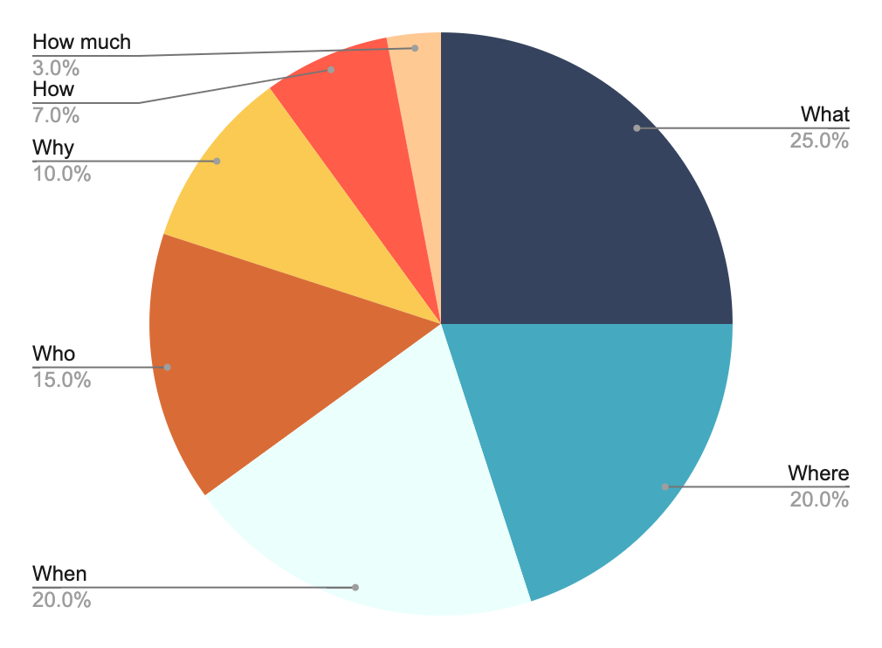
Project expenses
What
Why
Where
How
When
Who
How much
Follow the link in the graph to modify its data and then paste the new one here. For more info, click here

Slide 21
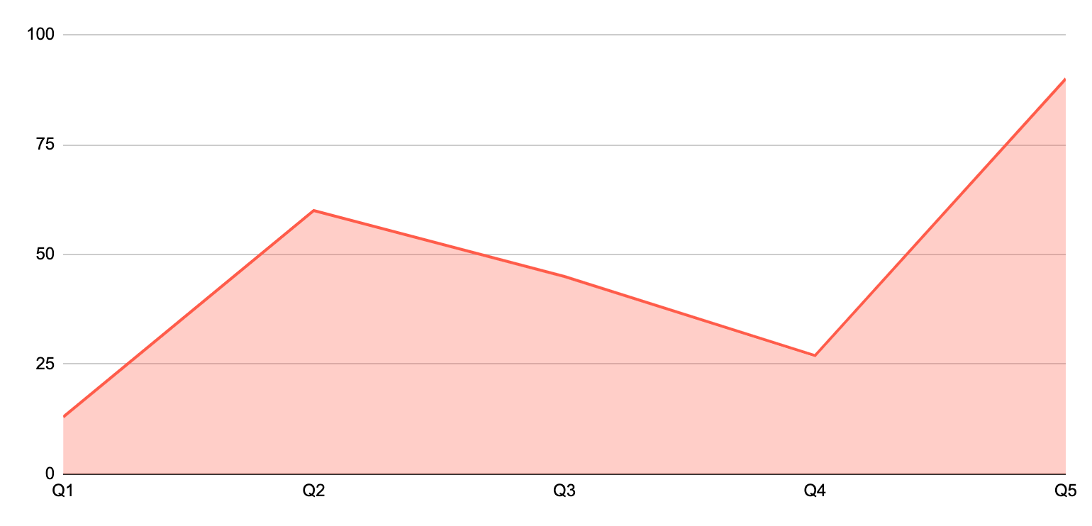
KPI dashboard
120 u/day
2h
Resource | Utilization rate | Cost per unit
Labor | 85% | $50
Equipment | 70% | $100
Materials | 95% | $20
Rent | 90% | $1,000
Energy | 80% | $80
Software licenses | 80% | $200
Advertising | 60% | $500
Output per worker
Time to complete a task
Follow the link in the graph to modify its data and then paste the new one here. For more info, click here

Slide 22
Thanks!
Do you have any questions?
youremail@freepik.com
+34 654 321 432
yourwebsite.com
Please keep this slide for attribution

Slide 23
Icon pack

Slide 24
Alternative resources
Here’s an assortment of alternative resources whose style fits the one of this template:
Hand drawn business party illustration I
Hand drawn trade show illustration II

Slide 25
Resources
Did you like the resources of this template? Get them for free at our other websites! Photos:
Industrial designers working on 3d model
Front view business man holding tablet
Medium shot business people working with ipad
Young business people in the office working with tablet
Vectors:
Hand drawn business party illustration
Hand drawn employee benefits illustration I
Hand drawn employee benefits illustration II
Hand drawn trade show illustration
Icons:
Icon Pack: Strategy | Flat

